Slide 1
CAI PROJECT - Analysis-
Git : https://github.com/slmteruto.CAI
Web : https://test.acorncai.kro.kr
Project Duration: 2020.02.01 ~ 2020.04.27
Project Team Members: Team Leader Yang Hee-seung, Team Members Park Jae-jung, Kim Eun-ju, Jo Ye-seul
Analysis Responsibility: Jo Ye-seul, Park Jae-jung

Slide 2
Contents
Chapter 01
Analysis Design and Approach
Reasons for Topic Selection and Data Collection Process
Chapter 02
Survey
Testing Rationality and Perception Comparison Through Surveys, Presentation of Survey Results
Chapter 03
Data Analysis
Conducting analysis using collected data, establishing algorithm criteria
Chapter 04
Key Summary

Slide 3
Report Objective
Society Emphasizing Individuality
Modern society values individuality, striving to enhance strengths, address weaknesses, and discover the most suitable beauty standards. In line with this societal trend, the concept of personal color has garnered public attention. Personal color refers to colors that harmonize best with one's hair, eye, and skin tones. Utilizing their personal color, individuals aim to present their best appearance and create their desired image.
Limitations of Personal Color Diagnosis
However, current methods for evaluating personal color lack clear criteria for selecting and diagnosing individual characteristics, relying primarily on qualitative sensory evaluations.
Overcoming these Limitations
To overcome these limitations, research is conducted on "the construction of a quantitative evaluation model for the classification of personal color skin tone types." This aims to identify quantitative criteria for classifying personal color types and develop suitable algorithms accordingly. Subsequently, through web implementation, the goal is to popularize personal color diagnosis among the public.

Slide 4
Data Approach
Analysis Topic and Hypothesis Setting
Data Collection
Data Cleaning and Processing
Data Analysis
Report Writing
Exploration of Papers on Color Theory and Personal Color
After reviewing the papers,
Selecting the primary area for color assessment and
Choosing the diagnostic colors.
Execution of a Survey on the Rationality of Personal Color Theory and the Selection of Assessment Areas and Diagnostic Colors
Collection of External Data
Data Cleaning and Processing for Validation of Collected Data
Analysis of Collected Data
Application of Multifaceted Analysis Techniques
Revision of Personal Color Classification Criteria Based on Analysis Results
Compilation of Data Findings
Desk Research
Survey Data
Data Preprocessing with Python
Statistics Result
Report Design
Set Personal Color Standards
Naver Searching Data
Data Analysis & Visualization with R
Output Image Design
Make Survey
Data Examination

Slide 5
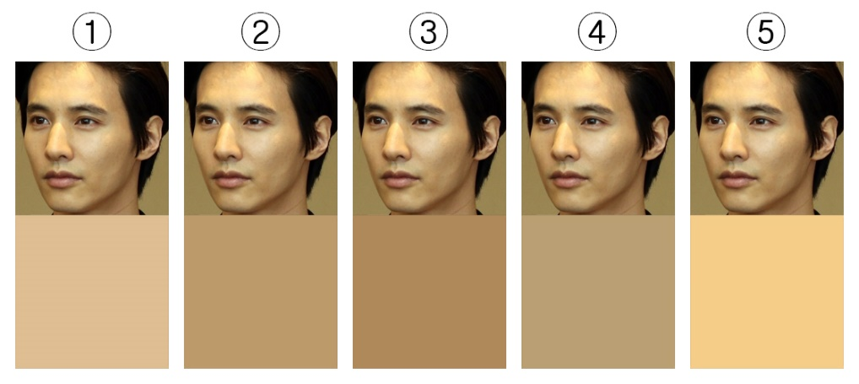
Make Survey
Rationality Verification of Personal Color Assessment Areas
Paper Findings:
Luminance: Differences in luminance exist pre and post makeup application across all areas.
Redness: No significant difference in redness across the entire face.
Yellowness: Differences in color values exist between the forehead and chin but not on the cheeks.
Conclusion drawn from the analysis suggests that women do not correct the yellowness of their cheeks compared to their foreheads and chins. This leads to the conclusion that the skin tone of the cheeks represents their overall skin tone, and preserving the cheek's skin tone is the most natural way to express individuality.
Hypothesis:
Is the cheek the representative skin tone of the face?
Example:
"Compared to the following picture, which color do you feel is most similar to the facial color?"
Verification Method:
Adjust the white balance of sample photos.
Extract the average color values for the forehead, cheeks, eyes, chin, and the entire face.
Conduct a survey to determine the facial area perceived as the representative skin tone when people recognize others' faces.
Present the average colors of the cheeks, chin, eyes, forehead, and the entire face for each facial sample.
Validate the results based on survey responses.
(From left to right: Cheek, Chin, Face, Eyes, Forehead)
Notes:
Conduct a survey to check whether the paper's standards are appropriate

Slide 6
Make Survey
Rationality Verification of Personal Color Diagnostic Colors
Paper Findings:
Personal color aims to make individuals appear brighter based on color theory.
Brightness enhancement in color theory is achieved through color contrast, luminance contrast, and saturation contrast.
Hypothesis:
Is the personal color perceived by individuals intended to make the skin appear brighter, or is it intended to complement the skin tone?
Verification Method:
For the base color (assumed to be skin tone), adjust the complementary colors according to color theory, selecting a total of 6 colors. Adjust the hue, luminance, and saturation values to present a total of 5 colors.
Conduct a survey to determine which color makes the base color appear the brightest or most harmonious, ensuring that the populations for the brightest and most harmonious colors do not overlap.
Survey A
(Color selection that makes the skin appear the brightest)
Q: When considering the color in the center of each palette as the skin tone,
Which color appears the brightest?
Survey B
(Color selection that complements the skin tone the most)
Q: When considering the color in the center of each palette as the skin tone,
Which color appears the most harmonious?
Notes:
Conduct a survey to check whether the paper's standards are appropriate

Slide 7
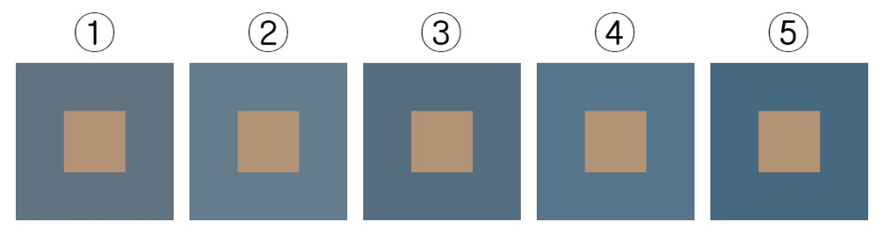
Make Survey
Rationality Verification of Personal Color Diagnostic Colors
Paper Findings:
Personal color aims to make individuals appear brighter based on color theory. Enhancing brightness in color theory involves color contrast, luminance contrast, and saturation contrast.
Hypothesis:
According to contrast theory, colors that contrast with the base color (skin tone) are perceived as most suitable for personal color.
Verification Method:
Using the base color as a sample, extract complementary colors, triadic colors, and split-complementary colors (total of 6). Fix the color values of each contrast and adjust the luminance/saturation to compare the colors.
Survey the most suitable color for personal color among each contrast and adjusted color.
Example:
When considering the color in the center of each palette as the skin tone, which color appears the brightest (most harmonious)?
Complementary color
Saturation -5 Brightness -5
Saturation -5 Brightness +5
Primary color
Saturation +5 Brightness -5
Saturation +5 Brightness +5
Notes:
Conduct a survey to check whether the paper's standards are appropriate

Slide 8
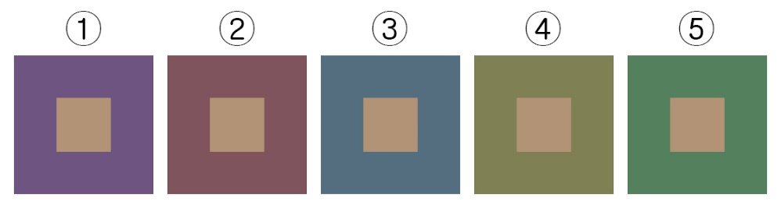
Make Survey
Rationality Verification of Personal Color Diagnostic Colors
Paper Findings:
Personal color aims to make individuals appear brighter based on color theory. Enhancing brightness in color theory involves color contrast, luminance contrast, and saturation contrast.
Hypothesis:
According to contrast theory, colors that contrast with the base color (skin tone) are perceived as most suitable for personal color.
Verification Method:
Using the base color as a sample, extract complementary colors, triadic colors, and split-complementary colors (total of 6). Fix the color values of each contrast and adjust the luminance/saturation to compare the colors.
Survey the most suitable color for personal color among each contrast and adjusted color.
Example:
When considering the color in the center of each palette as the skin tone, which color appears the brightest (most harmonious)?
Complementary color
Color - 144$°$
Color - 72$°$
Primary color
Color + 72$°$
Color + 144$°$
Notes:
Conduct a survey to check whether the paper's standards are appropriate

Slide 9
Make Survey
Survey for Comparing Personal Color Perception
Goals
Verification Methods
Investigate whether there are differences in color perception based on age and gender.
Add age and gender items to the survey questions.
- Investigate whether there are differences in color perception for each survey item.
- Add a check item for level of interest in fashion.
- Assume that those with a high interest in fashion will have a higher interest in color and better color distinction abilities.
Determine if there are differences in perception of personal color based on level of interest in fashion.
Explore whether differences in perception of personal color exist based on individuals' understanding and preference of the concept.
- Survey whether the perceived personal color concept aligns with making the skin appear brighter or harmonizing with the skin tone.
- Assess whether differences in perception of the concept lead to differences in color perception.
- Add an item for the purpose of using personal color (styling, makeup, etc.).
- Decide whether to associate the survey results with the data from the "Musinsa" project conducted during the mid-term project phase and determine how to utilize personal color measurements in the future.
Determine the purpose of using personal color through surveys to assess future utilization.
Notes:
Conducting a survey on personal color perception

Slide 10
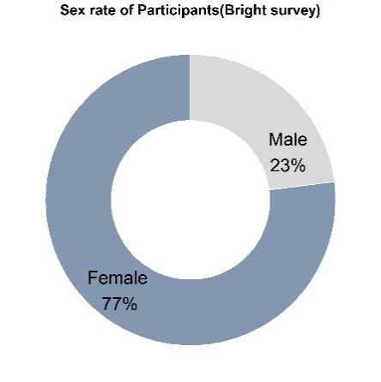
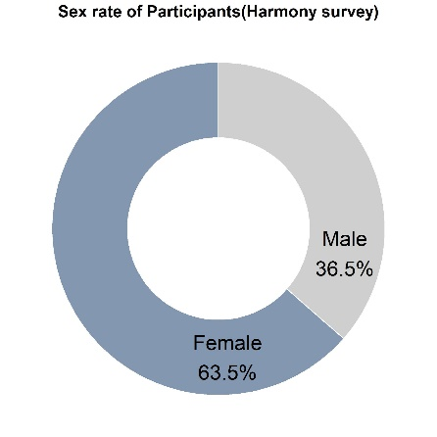
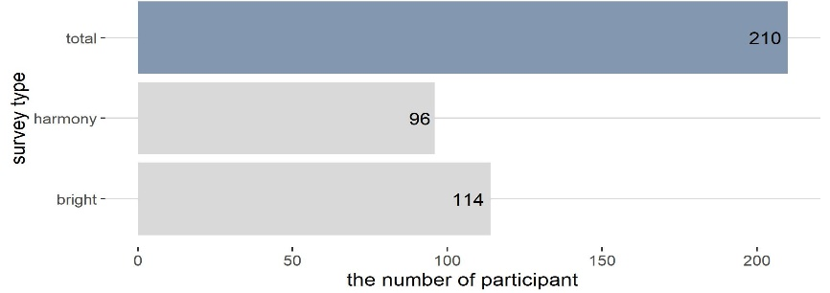
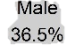

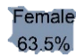
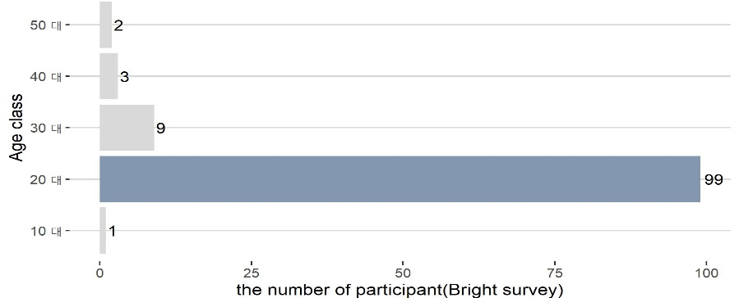
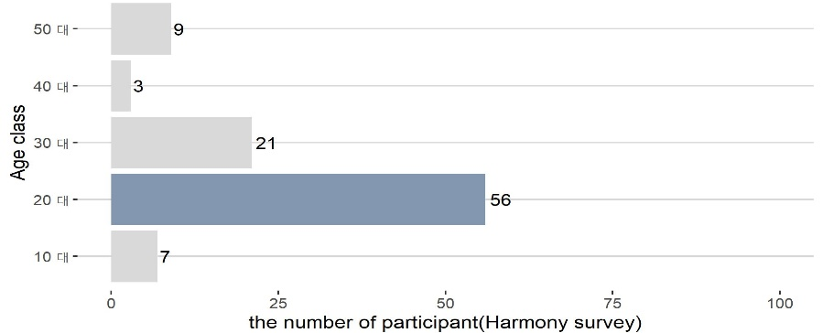
Survey Result
Survey participation results
Number of survey participants
Ratio of men and women in survey
Bright
total 114
Harmony
total 96
Number of people in the survey by age
Notes:
Conduct a survey to check whether the paper's standards are appropriate
Retouching the donut graph with Photoshop!!!!!!!!!!!!!!!!!

Slide 11
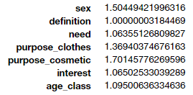
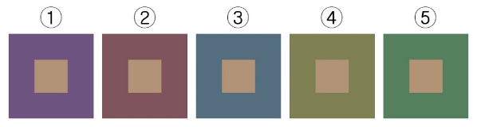
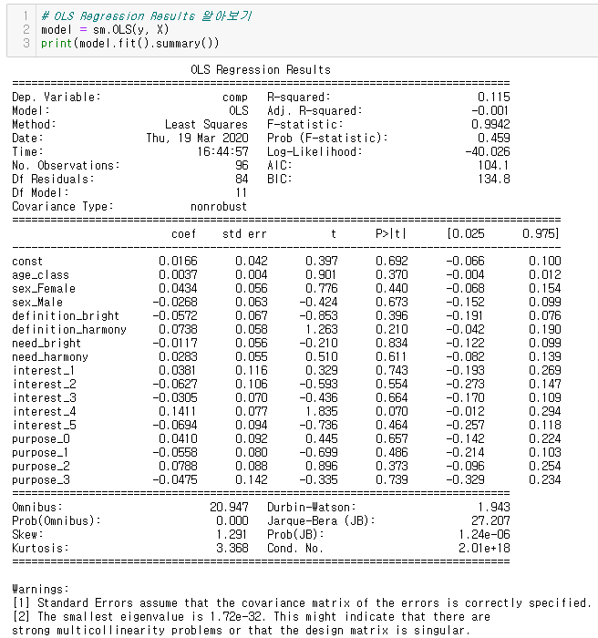
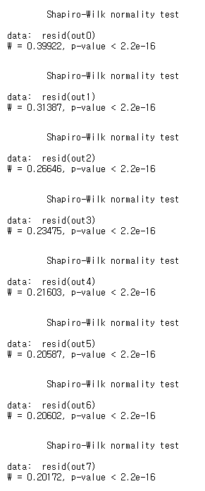
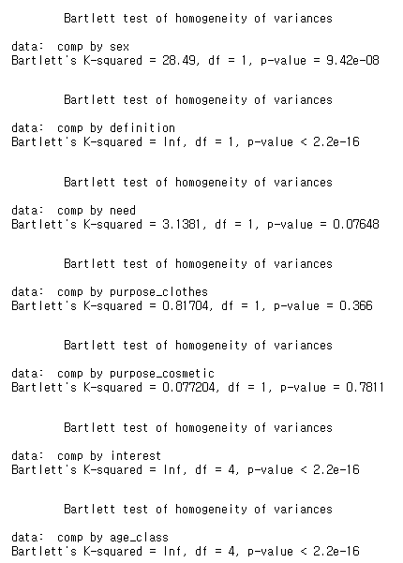
Logistic regression analysis is a method used to understand the impact of independent variables on a dependent variable and to produce a model that predicts the value of the dependent variable corresponding to certain values of the independent variables.
Data Analysis
Condition 1
Logistic regression analysis is suitable when the dependent variable is measured as a categorical qualitative variable on a nominal scale.
Condition 2
There should be no multicollinearity among the independent variables.
보색
색상 - 144$°$
색상 - 72$°$
원색
색상 + 72$°$
색상 + 144$°$
https://github.com/slmteruto/CAI/cys/CAI_Logistic_useR.ipynb
In this case, the dependent variable is the selection of correct or incorrect answers regarding personal color. Since the selection of correct and incorrect answers constitutes a categorical variable, logistic regression analysis is appropriate.
Using the square root of the variance inflation factor (VIF), no value exceeds 2. Therefore, it is determined that there are no issues with multicollinearity among the variables.
Condition 4
The values of the dependent variable corresponding to the independent variables should follow a normal distribution, and the variances of all normal distributions should be equal.
Condition 3
The values of the dependent variable should be statistically independent of each other.
Using sm.OLS(), the Durbin-Watson statistic is not significantly different from 2. Therefore, it is concluded that the values of the dependent variable are independent.
The p-value from the Shapiro-Wilk test is less than 0.05, indicating that the data does not follow a normal distribution. Additionally, the p-value from the Bartlett test is less than 0.05, indicating that the variances are not equal.
https://github.com/slmteruto/CAI/cys/CAI_Logistic_usePython.ipynb
https://github.com/slmteruto/CAI/cys/CAI_Logistic_useR.ipynb
Notes:
Categorical qualitative variables: Variables that are measured by categorizing the survey subjects based on their characteristics, known as categorical variables. Multicollinearity: Refers to the strong correlation between independent variables.
By examining the ratio of correct answers according to independent variables such as age and gender, we can identify the main target audience and assess the validity of the paper.

Slide 12
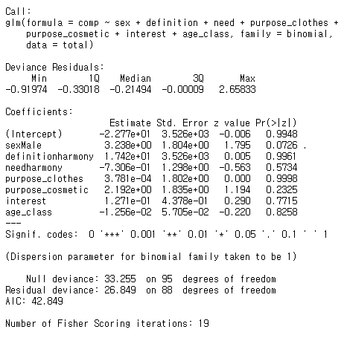
Data Analysis
Based on the previous results, since our data does not follow a normal distribution and does not have equal variances, logistic regression analysis cannot be used. Consequently, attempts to identify significant variables for building a logistic regression model were unsuccessful.
The goal was to use logistic regression analysis to identify groups with high survey accuracy and plan algorithms accordingly. However, this is not feasible.
■ glm() : Function used to identify statistically significant variables in logistic regression analysis.
■ Call : Presentation of the constructed model.
■ Coefficients의 Pr
: p-value of the constructed model.
: Variables with p-values less than 0.05 are statistically significant.
: The variable with the lowest p-value indicates the strongest predictive power.
■ Interpretation of Results (Displayed in the left figure)
Survey B (Harmony)
Among the fixed color items, the complementary color sample
All variables have p-values greater than 0.05
-> None of the variables can be considered statistically significant.
https://github.com/slmteruto/CAI/cys/CAI_Logistic_useR.ipynb
Notes:
Actually, there were no significant variables identified for constructing the logistic regression model.
What were you trying to predict with this?
-> I was trying to identify which group had a high success rate in predicting correct answers and plan algorithms based on that group's opinions.
+ Call: Reviewing the constructed model.
+ Deviance Residuals: Provides information about deviance residuals, which is a measure of how well the model fits the data. It helps evaluate whether the model is well-fitted.
+ Coefficients: Displays regression coefficients, their standard deviations, z-statistics (Wald's z-statistics), and p-values. Variables with p-values less than 0.05 are considered statistically significant. The variable with the lowest p-value has the strongest predictive power.
+ Null deviance: Deviance when there are no variables other than the constant term.
+ Residual deviance: Lower values are better. Since it follows a chi-square distribution, we can use the chi-square goodness-of-fit test to determine if the model fits well.
For elementaryItem + hueFixed (Survey 2), if sV is the correct answer

Slide 13
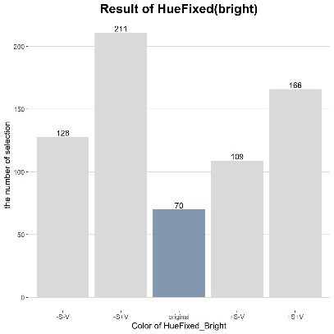
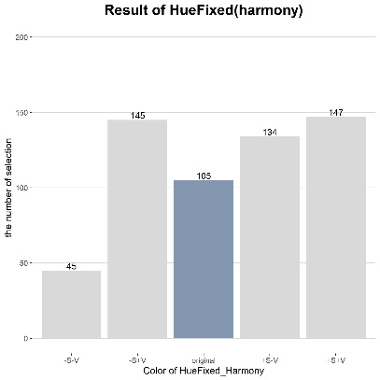
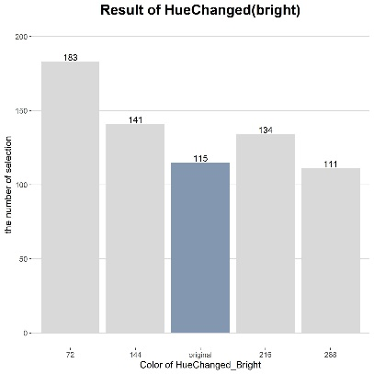
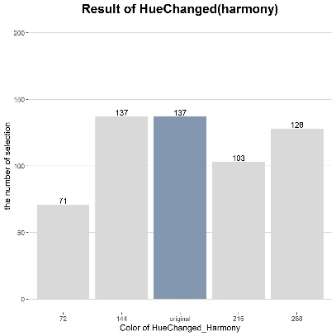
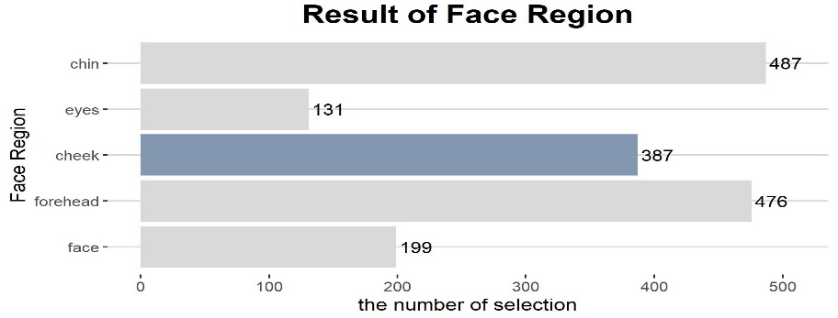
Data Analysis
- Furthermore, except for the item in the survey questionnaire that asks about harmony with facial color, where the color change item is excluded, the selection rate for correct answers is low in all other items.
- According to color theory, facial color is expected to appear brightest when it is accompanied by complementary colors, triadic colors, and split-complementary colors. However, colors that have been adjusted in terms of hue, saturation, and brightness from the primary colors receive more selections than the primary colors themselves.
- The cheek is considered as the facial area representing the overall facial color as set in the paper. However, the survey results show that the number of selections for the cheek is low.
- The reason for the low selection of items related to the color selection area and diagnostic color is believed to be primarily due to significant differences in people's perceptions.
- As a result of these findings, it is concluded that it is difficult to believe in the accuracy of the paper and theory.
Notes:
Therefore, it is decided to select a group that is deemed to have the most interest in personal color using different data sources. Based on the answers chosen by this group, algorithms will be established.

Slide 14
Data Analysis
Reasons why the data analysis using survey results was not properly conducted
Internal Factors
1. Insufficient learning and understanding of the analysis method before proceeding with survey writing
It is considered that the number of options (5) provided during the survey on diagnostic colors was too high.
If the survey writing had been conducted with a clear direction of 'prediction analysis based on correct and incorrect answer rates', only two options would have been provided.
Then, people could have made easier and faster choices, and the analysis would have proceeded in the desired direction.
2. Setting more independent variables
To increase the survey participation rate, only the minimum elements were included in the survey, thinking that the number of questions should be minimal.
However, it is judged that if there had been more diverse independent variables, multidimensional analysis would have been possible based on the results of logistic regression analysis.
External Factors
1. Need for more survey participants
Currently, there are about 200 survey participants.
There were limitations in only asking acquaintances of the team members.
2. Distribution of survey participants
It is judged that more objective survey results could have been obtained if the distribution of participants' age and gender had been uniform.
Alternatively, if a specific group had been the focus, more standardized survey results could have been obtained.
Notes:
Therefore, Naver Data Lab was used.
There is an original correct answer, but...

Slide 15


Data Analysis
Therefore, it is decided to select a group deemed to have the most interest in personal color using different data sources. The algorithms will be based on the answers chosen by this group.
Survey
Data
Extension
?
Using Naver Data Lab's search trends
Data that indexes the search volume trends for specific keywords.
High market share of Naver in South Korea.
Search trends can be segmented by age and gender.
Data can be obtained in formats other than graphs.
Data Collection
Notes:
Selection of a group interested in personal color.
Understanding the differences in people's perceptions of the concept of personal color.
Determining the results of the selected color areas and diagnostic color choices by this group within the survey.
Identifying the purpose of personal color.

Slide 16
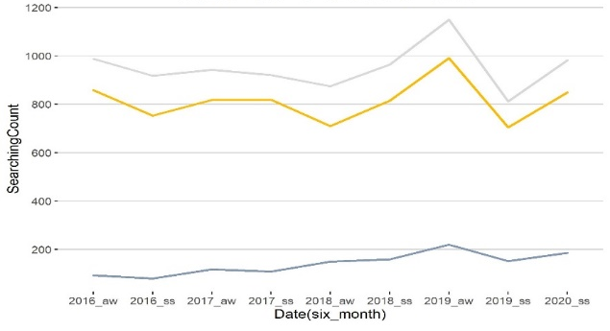
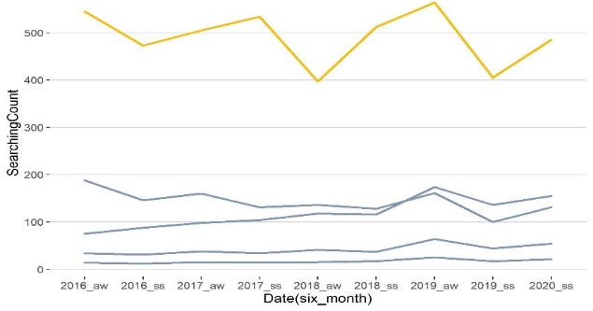

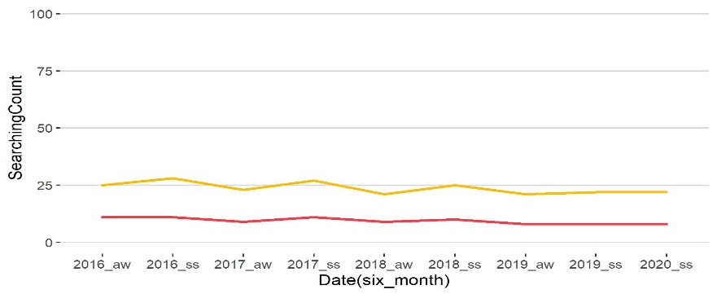

Data Analysis
Setting Algorithm Criteria
Search frequency for personal color by gender
Search frequency for personal color by age among females
All
20s > Other ages
20s Female
FEMALE > MALE
Female
10, 30,
40, 50s Female
Male
The search volume for females is overwhelmingly higher than for males
The search volume for women in their 20s is overwhelmingly high, indicating a significant interest in personal color. Therefore, this group is designated as the representative group
Search frequency for the definition of personal color among women in their 20s
The search frequency for the definition of personal color among the designated representative group of women in their 20s shows little variation.
Thus, on the website, it is decided to present the colors that:
Both show harmony with facial color and make the facial color appear brighter.
Make the face appear brighter will reflect adjustments in brightness and saturation.
Show harmony with facial color will reflect adjustments in color values.
< Search Method >
Period: January 2016 – February 2020 (averaged every 6 months)
Keywords:
Personal Color: personal color
Bright: bright, light, brightly, lightly
Harmony: harmonious, balanced, well-matched, in harmony
Bright ≒ Harmony
https://github.com/slmteruto/CAI/cys/CAI_DataLab_definition.ipynb
Bright
Harmony
https://github.com/slmteruto/CAI/cys/CAI_DataLab_RepresentativeGroup.ipynb

Slide 17
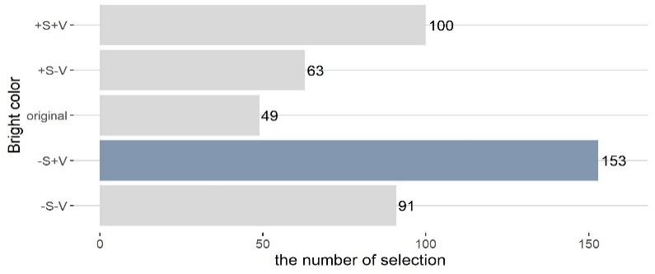
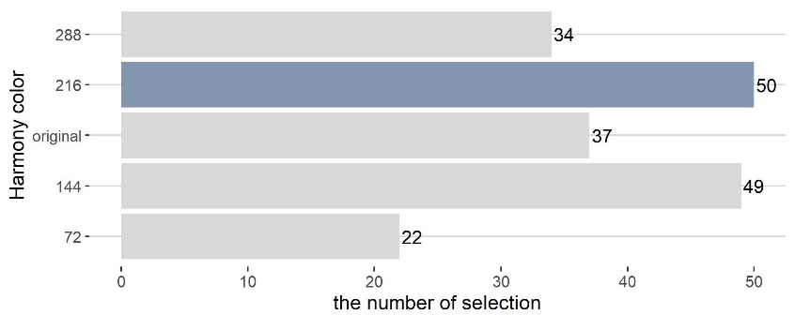
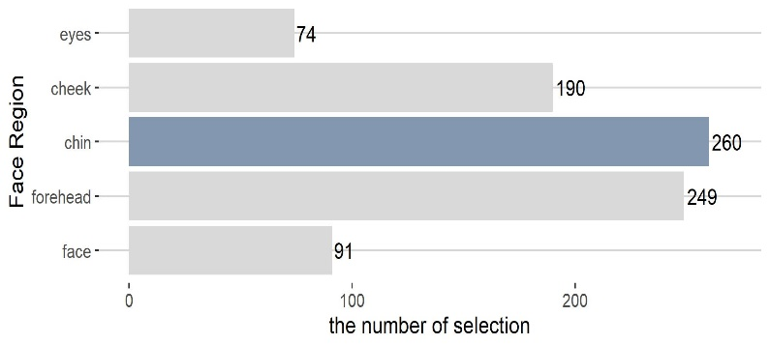
Data Analysis
Algorithm Implementation Criteria
Representative color values that make the face appear brighter
Representative color values that show harmony with the facial color
According to women in their 20s, the color values that make the face appear the brightest are achieved by decreasing the saturation by 5 and increasing the brightness by 5 for each complementary color's primary color.
According to women in their 20s, the color values that show the most harmony with the facial color are achieved by increasing the hue by 72 degrees for each complementary color's primary color.
Representative facial area
< Algorithm Criteria Setting >
Based on the choices of women in their 20s from the survey
Representative facial area: Chin
Color values that make the face appear brighter: Decrease the saturation by 5 and increase the brightness by 5 for each complementary color's primary color
Color values that show harmony with the facial color: Increase the hue by 72 degrees for each complementary color's primary color.
According to women in their 20s, the facial area that has a color most similar to the overall facial color is the chin
https://github.com/slmteruto/CAI/cys/CAI_ServeyResult.ipynb

Slide 18
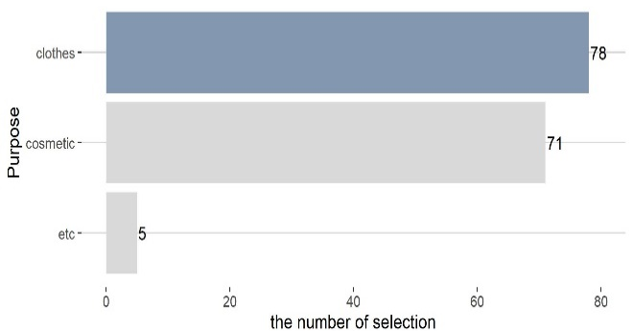
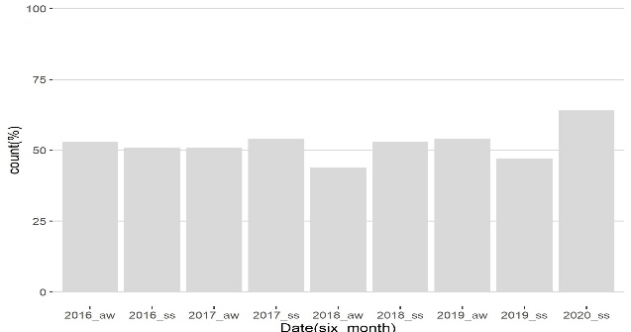
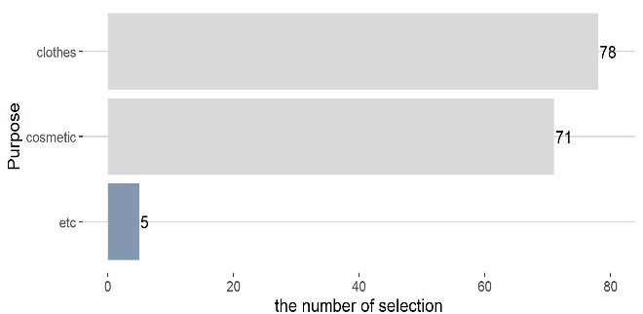
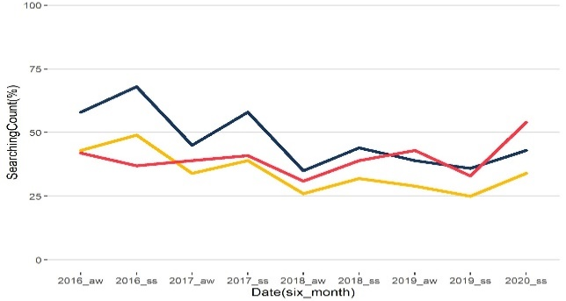
Data Analysis
Personal Color Purpose
Personal Color Purpose for Clothing
Results of Personal Color Purpose Survey
Search Results for Personal Color Purpose for Clothing
According to the survey, the most common purpose for using personal color is matching clothing.
Using Naver Data Lab to analyze search results for the personal color purpose for clothing shows an upward trend.
It was concluded that matching with "Musinsa clothing," used in the midterm project, would be beneficial.
Results of Personal Color Purpose Survey
Results of Personal Color Purpose Survey
Search Results for Personal Color Purpose
When surveying the purpose of personal color, many respondents indicated they wanted to use it for accessories and hair dyeing.
Using Naver Data Lab to analyze search results for each purpose, accessories show an upward trend, while makeup and hair dyeing show a downward trend.
Therefore, it is anticipated that it would be beneficial to introduce a recommendation system on the website in the order of accessories, makeup, and hair dyeing.
Cosmetic
Dye
Accessory

Slide 19
“
”
Personal Color Data Analysis Results
Algorithm Criteria Set Using Surveys and Naver Data Lab:
Representative Group: Women in their 20s
Representative Facial Area: Jaw
Color Value to Make the Face Look Brighter: Decrease saturation by 5 and increase brightness by 5 for each complementary color's original hue.
Color Value to Show Harmony with the Face: Increase hue by 72 degrees for each complementary color's original hue.
Personal Color Usage Purposes
Survey results show high responses for using personal color in clothing matching.
Naver Data Lab also shows a consistent increase in searches linking personal color with clothing.
It is deemed beneficial to include a fashion item recommendation system on the website.
Cosmetics, hair dyeing, and accessories are selected as additional recommendation systems for future implementation.

Slide 20
Thank you

